Slide 1

"KajBazar" – A Local Skill Marketplace App
A Trusted Friend Nearby

Slide 2
Presented To:
Presented By:
Jawad Hossain
Lecturer,
Department of CSE
University of Asia Pacific
Sumayea Akther Samia(22201075)
Tanzim Tabia(22201080)
Mahinur Akther(22201100)

Slide 3
About KajBazar
KajBazar is an innovative platform where individuals can learn daily, practical, and professional skills from expert trainers.
We focus on delivering real-world knowledge that leads to real earning opportunities.
After skill development, we connect learners with partner agencies and companies to begin their career journey.

Slide 4
The Problem
Lack of access to practical, real-world skills.
Traditional education focuses on theory, not practical skills.
Limited availability of expert-led training for everyday skills.
People struggle to become self-reliant in daily tasks.
Difficulty in finding verified experts for skill training.

Slide 5
Purpose
Create a platform for practical skill learning.
Provide access to expert-led training courses.
Empower individuals with skills for daily life and careers.
Make skill learning flexible and accessible.
Offer recognized certification for skill mastery.

Slide 6
Feature:
User Module:
User Registration and Login.
Profile Management (Personal Details, Interests).
Course Enrollment and Progress Tracking.
Ratings and Reviews for Courses.
Secure Payment System.

Slide 7
Feature:
Instructor Module:
Profile Creation and Management.
Course Creation and Management.
Schedule Management for Classes.
Student Interaction (Q&A, Live Sessions).
Earnings Dashboard and Payment Management.

Slide 8
Feature:
Admin Module
User and Account Management.
Instructor Verification and Management.
Course Review and Approval.
Issue Handling and Support System.
Platform Analytics and Reporting.
Database Management and Security.
Legal Compliance and Content Moderation.

Slide 9


Slide 10
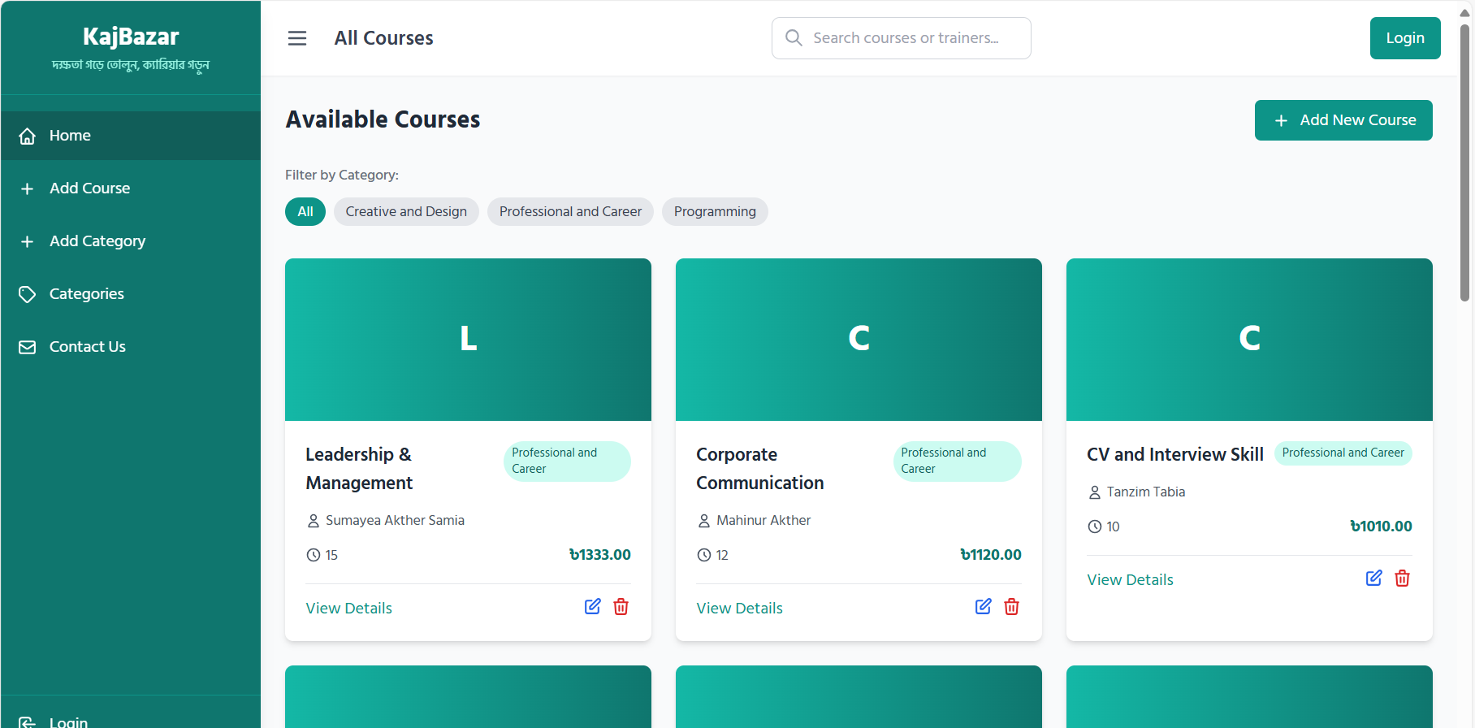

Slide 11
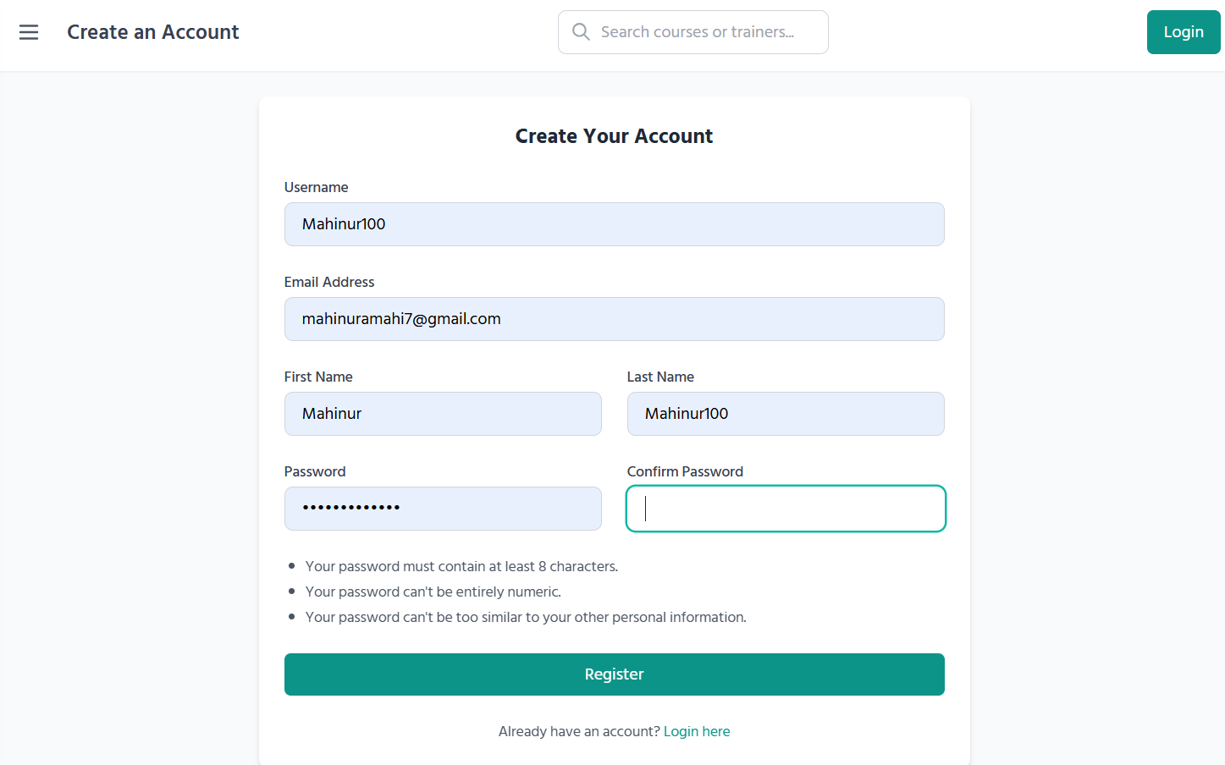

Slide 12
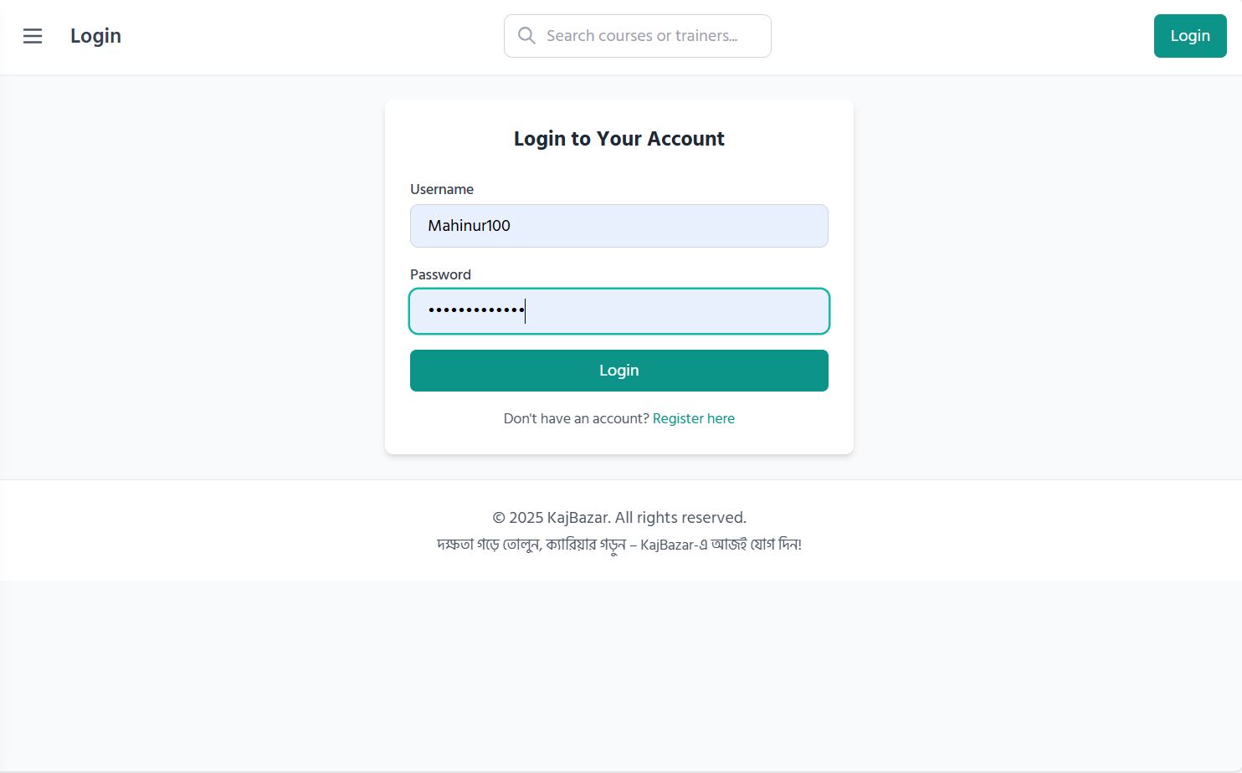

Slide 13
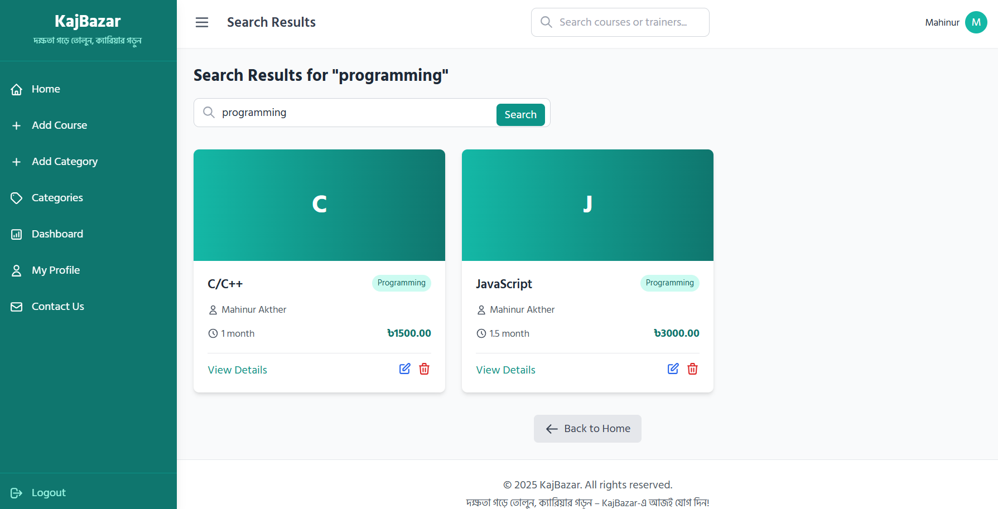

Slide 14
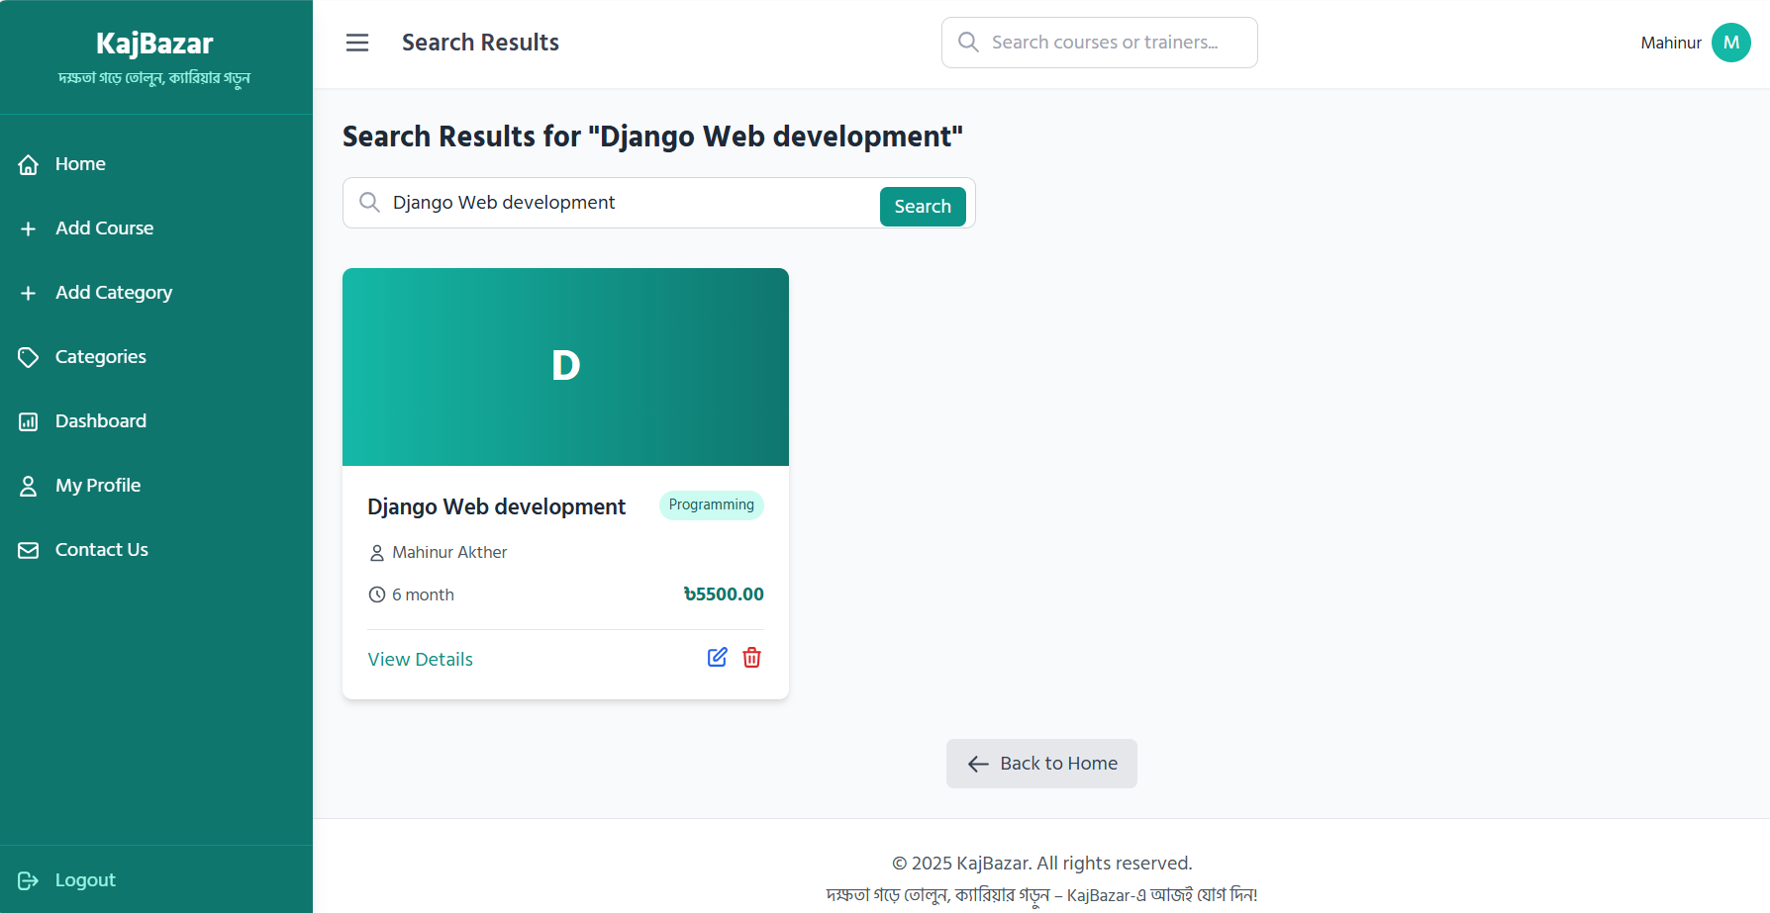

Slide 15
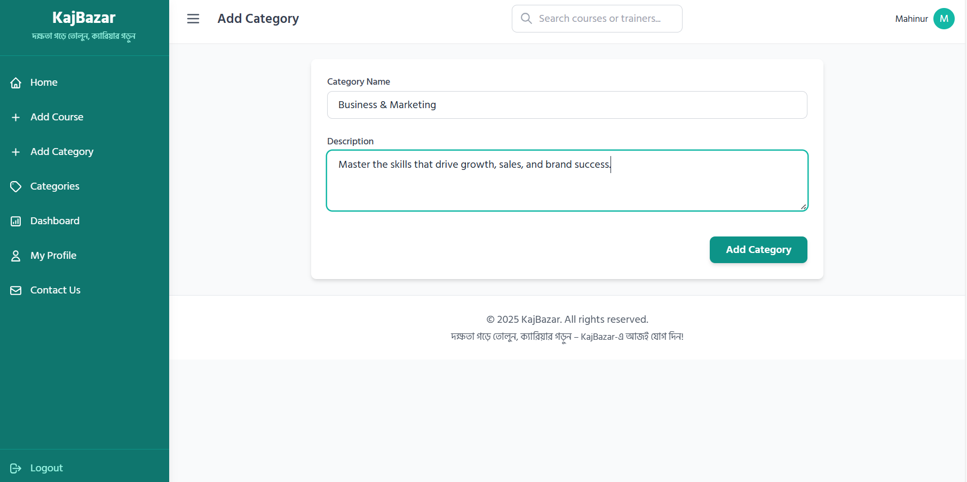

Slide 16
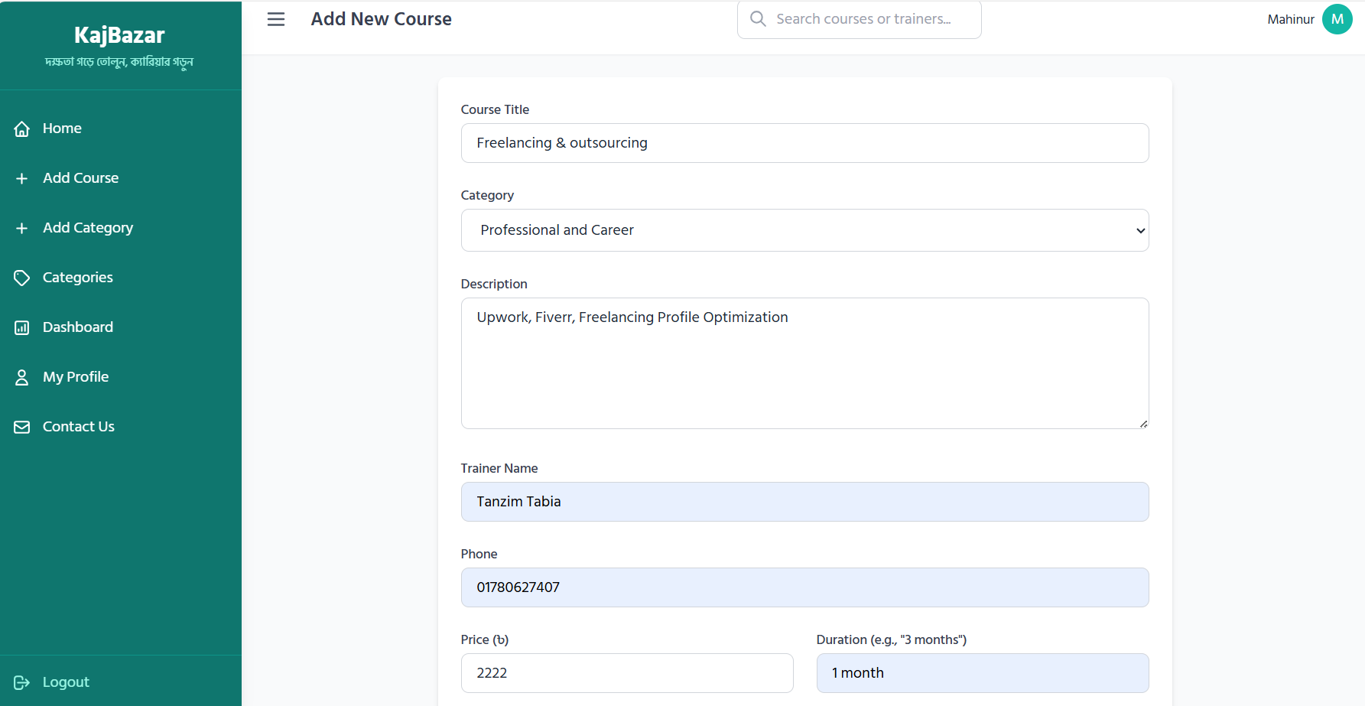

Slide 17
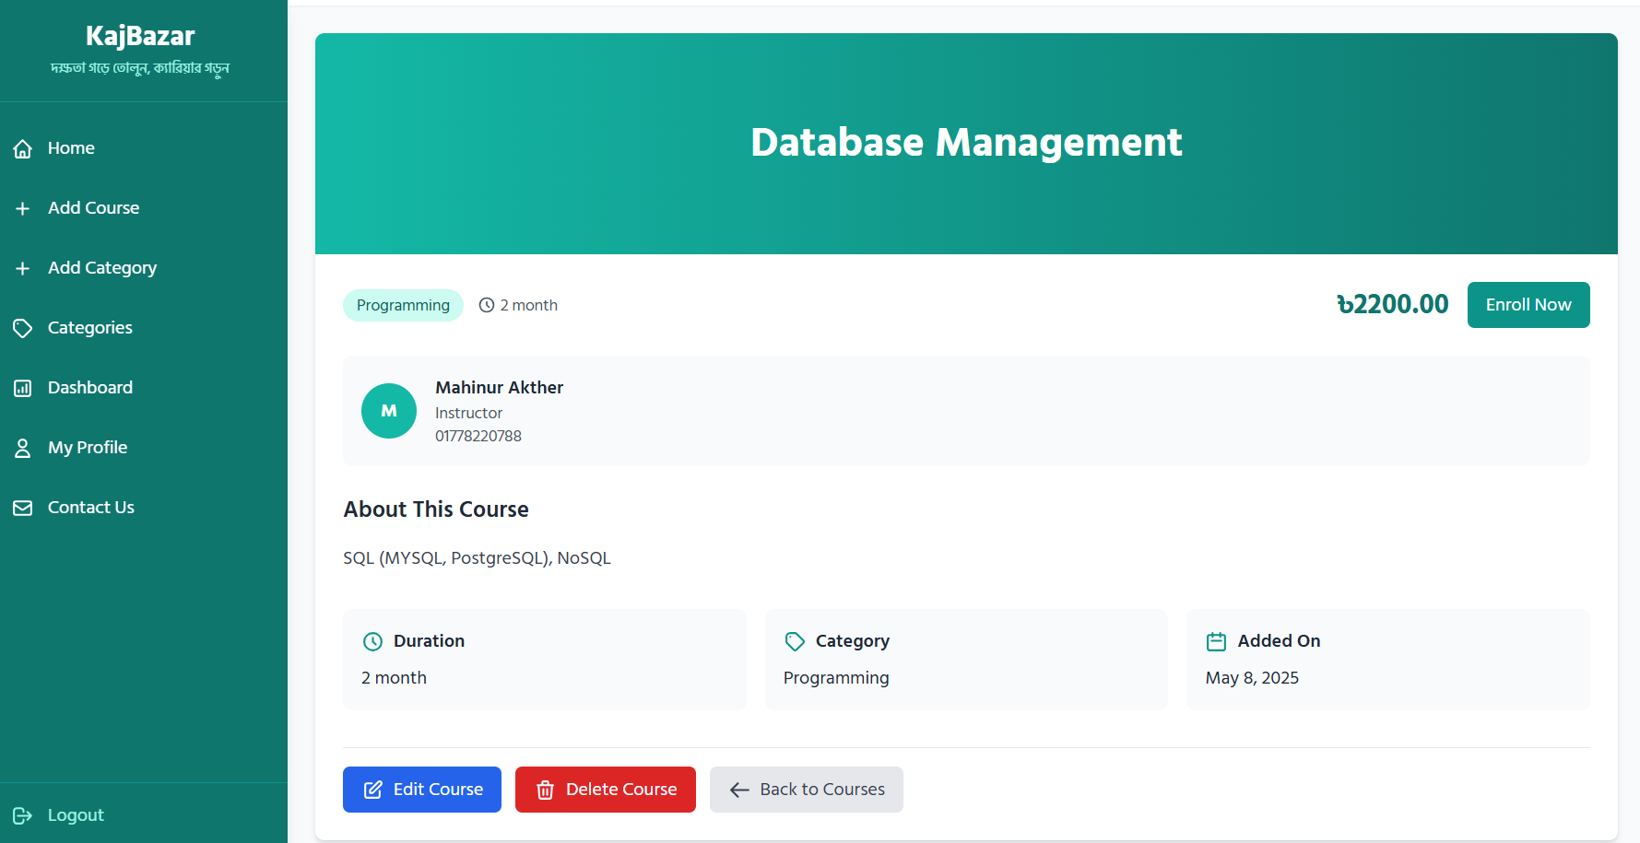

Slide 18
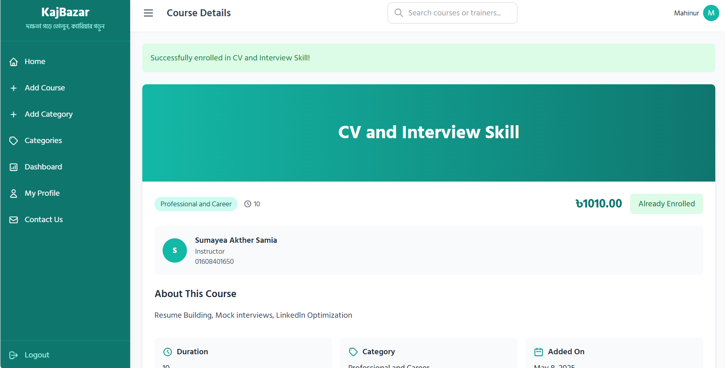

Slide 19
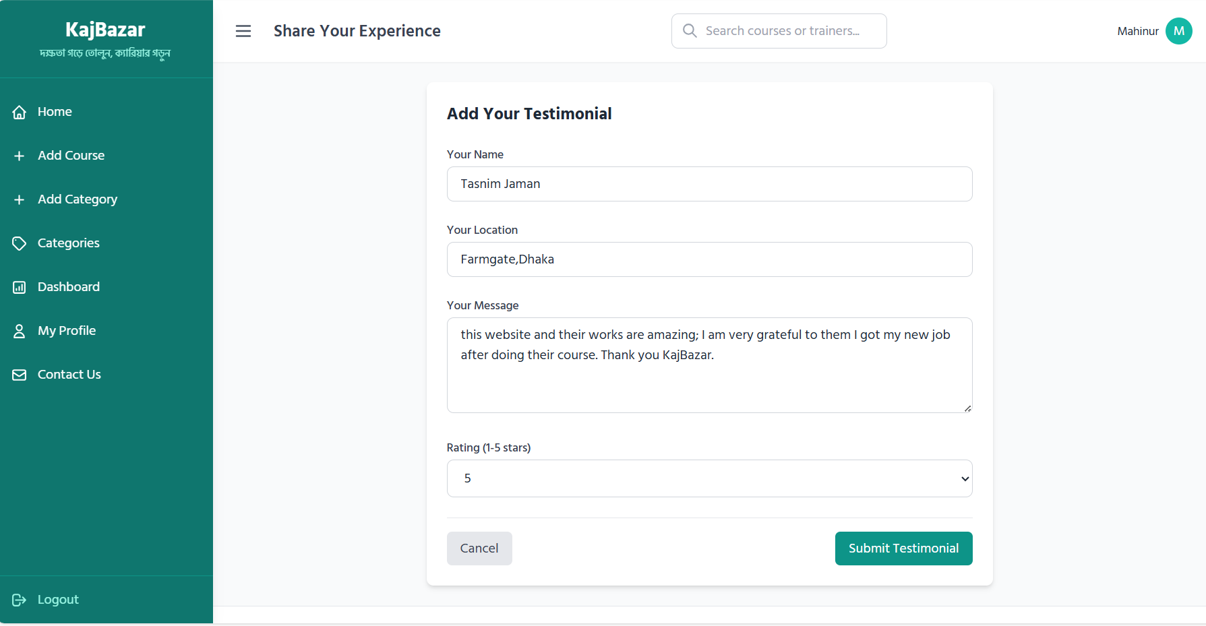

Slide 20
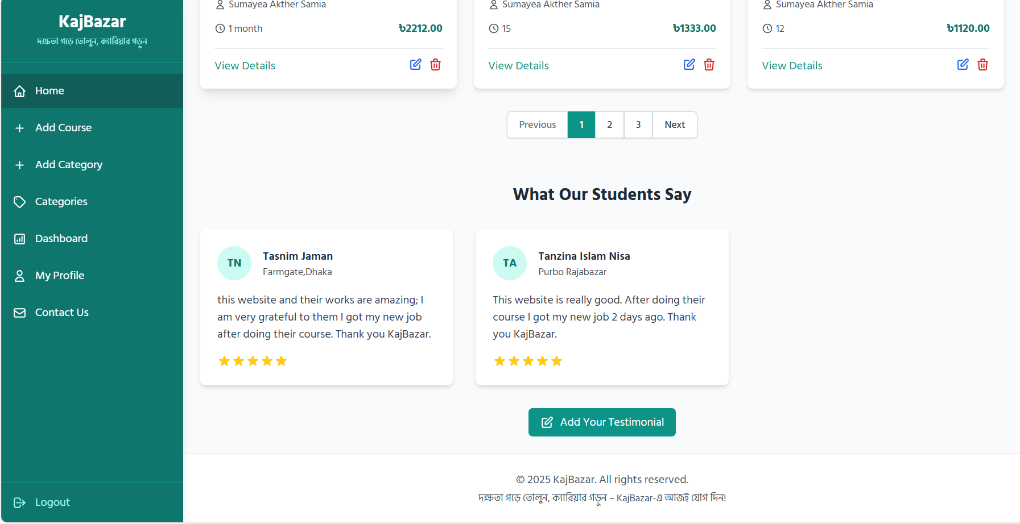

Slide 21
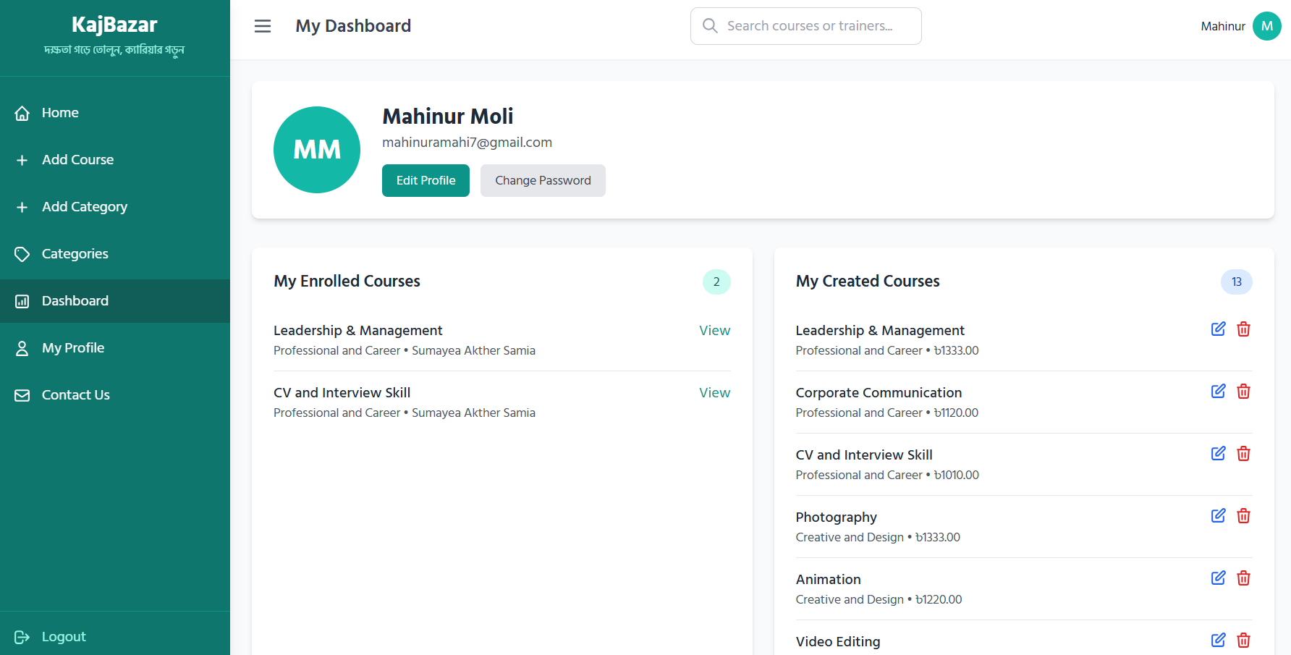

Slide 22
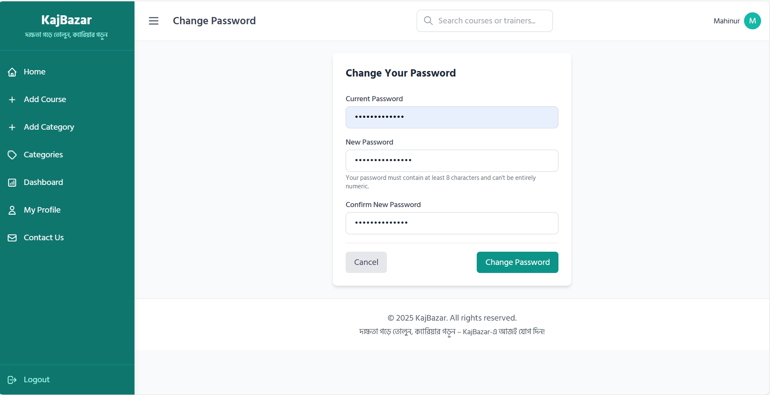

Slide 23
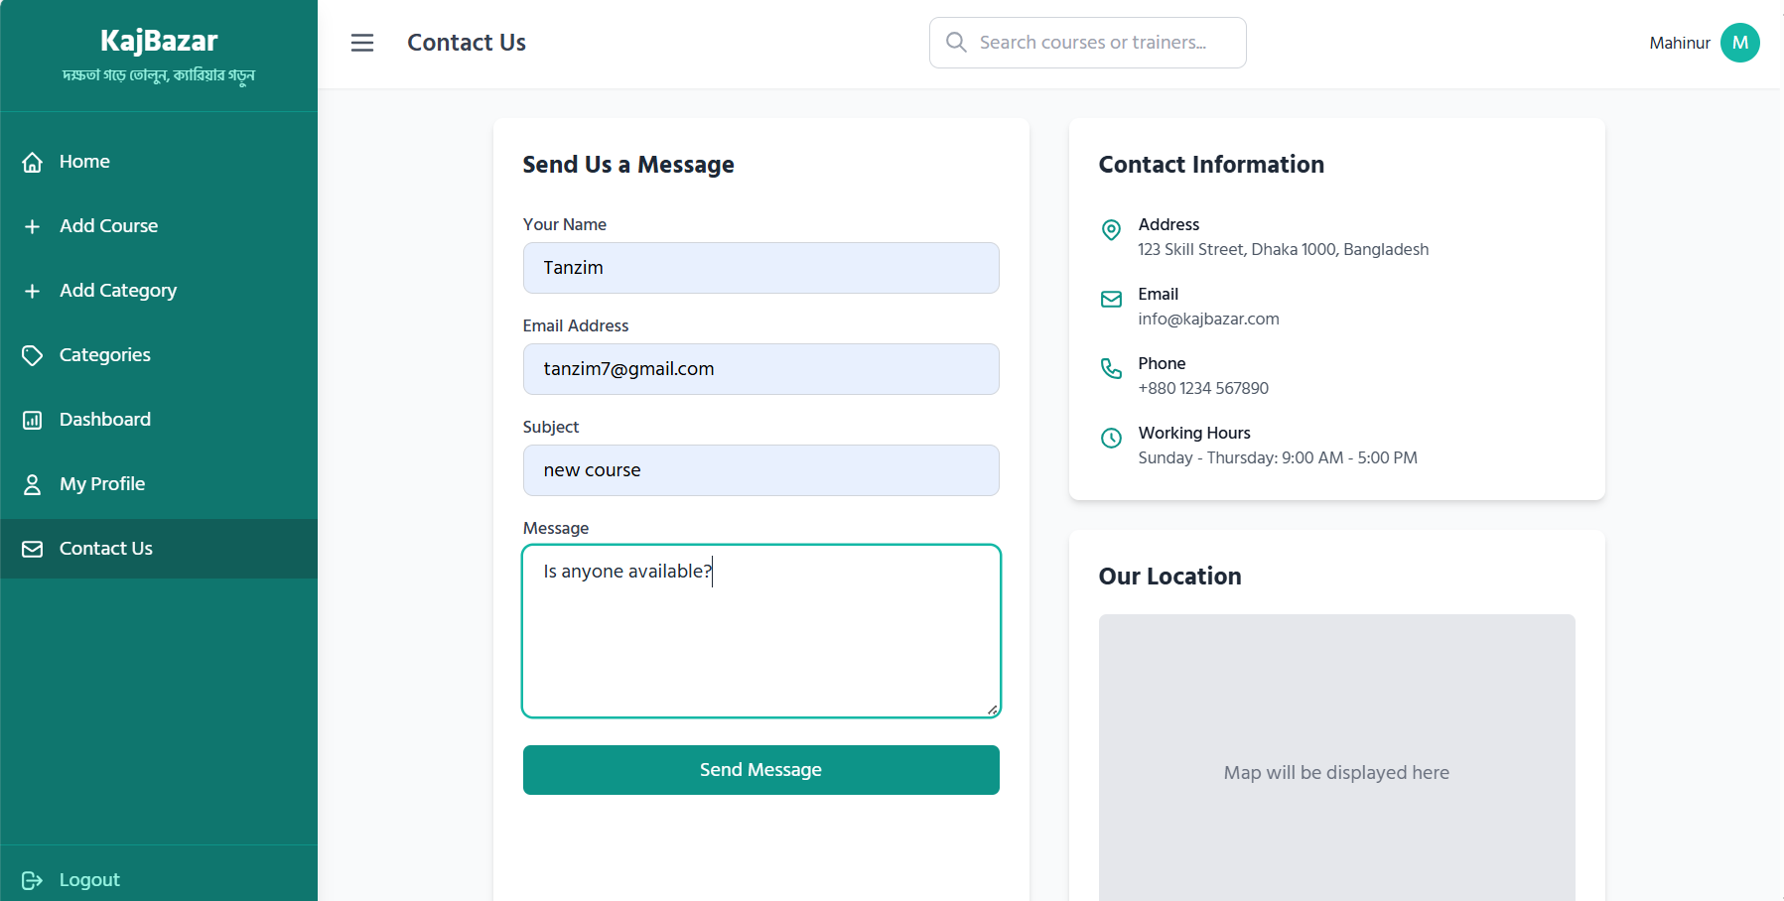

Slide 24
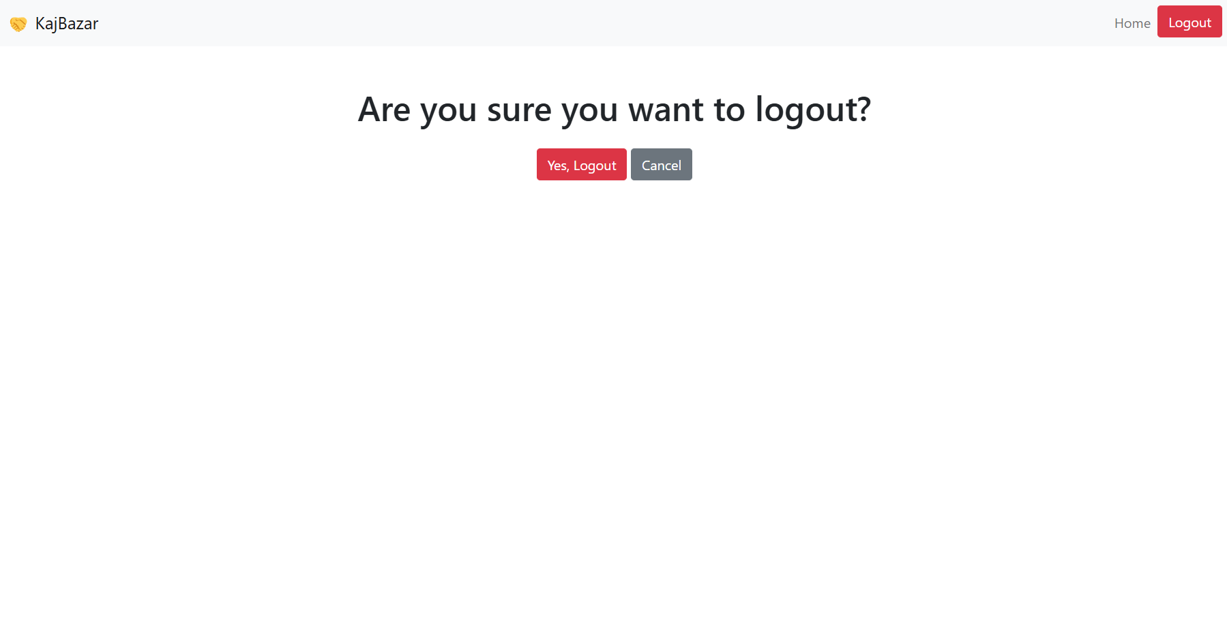

Slide 25
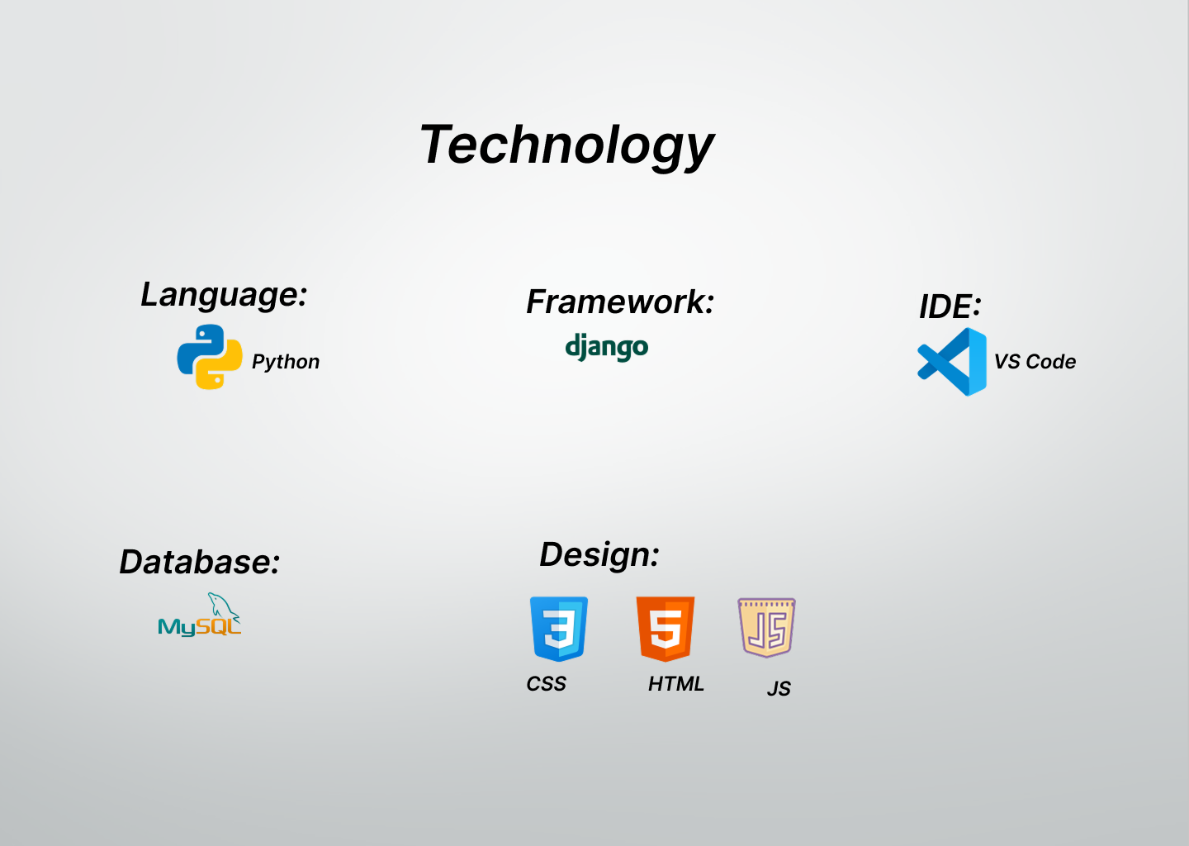

Slide 26
Thank You
Let's Grow Skills. Let's Grow Futures.

Slide 27
Any Question???

